Slide 1
To Do List Java Web App
by
Ashley Paddock
and
Danilo Da Silva

Slide 2
What the program does
Uses JavaServer Faces – a component based MVC Framework.
Through any web browser, the user may open his or her personal To Do List
Activity Title
Description
Priority Level
The user can edit Item parameters as well add and remove items at will

Slide 3
Design Pattern Choices
Observer Pattern
MVC architecture for overall program structure
View in JSP File, Model for Data Storage and Controller for Methods in JAVA files, each in appropriate packages
Strategy Pattern
view using layout tools for dynamic view
Composite Pattern
Using CSS Styling for JSP file with HTML code
Decorator Pattern
Change preset methods and classes for our program

Slide 4
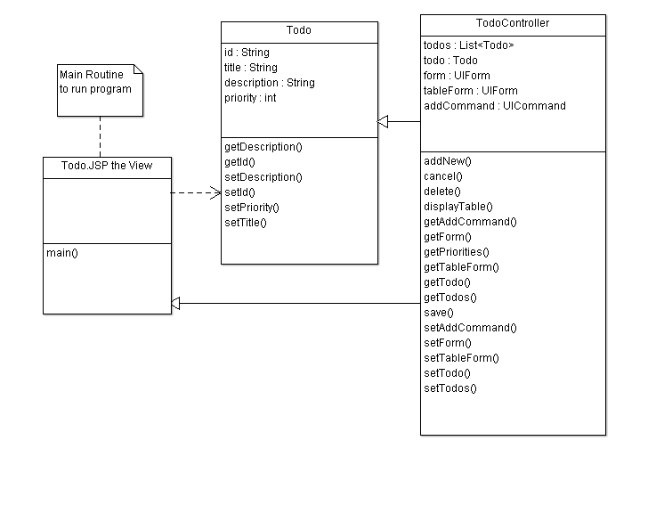

Slide 5
